Slide 1
CONTACT MANAGER
Managing Customer Relations
Effectively
PRESENTED BY
PRIYADHARSHINI

Slide 2
We are pleased to inform you that your team has been successfully enrolled for the project. please find the team details below Team Leader: Ashwathi.V Team Members: Indumathi.E Priyadharshini.B Jeevanya.G Jeyashree.R

Slide 3

1.INTRODUCTION
A Contact Manager System is a software application used to store and manage contact information in an organized way. It helps users save details like name, phone number, email, and address. Instead of writing contacts manually, this system stores them digitally so they can be easily accessed, edited, or deleted. The main goal of this project is to make contact management simple, fast, and efficient.

Slide 4
2.OBJECTIVE
To store contact details digitally.
To make searching contacts easy and fast.
To allow users to add, edit, and delete contacts.
To organize contact information in a structured format.
To reduce manual work and avoid loss of contact details.

Slide 5

3.FETURES
Add Contact – Add new contact details.
View Contacts – Display all saved contacts.
Search Contact – Find a contact using name or number.
Update Contact – Edit existing contact information.
Delete Contact – Remove unwanted contacts.

Slide 6
4.Technologies Used
.Programming Language:
Java / Python / C based on contact manager
.IDE:
VS Code / Eclipse / NetBeans
.Database:
File System / MySQL

Slide 7

5.SystemRequirement
Hardware requirements computer or laptop minimum 4GB RAM
Software requirements Java JDK any IDK(Eclipse/NetBeans)

Slide 8

6.Working of contact manager
.User opens the application user can add a new contact contacts are stored in database/fileUser can search,edit,or delete contacts

Slide 9


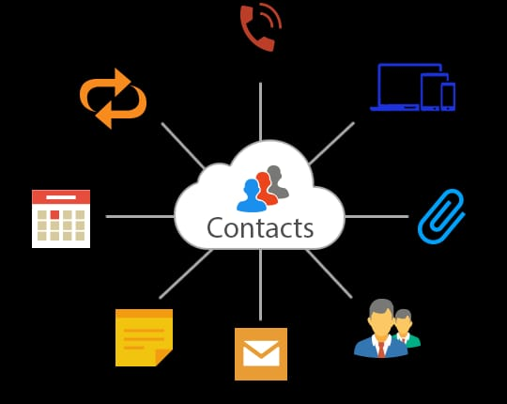
7.Conclusion
-The Contact Manager System helps users manage their contacts easily and efficiently.
-It reduces manual work and keeps contact information organized.
-It allows adding,updating,deleting,and searching contact quickly.
-This project shows hoe technology can make contact management simple and efficient.

Slide 10
THANKYOU
BY
ashwathi
PRIYADHARSHINI
INDUMATHI
JEYASHREE
JEEVANYA

